Slide 1
b. Boundary-layer effects
Once the surface energy budget is altered, fluxes of heat, moisture, and momentum within the planetary boundary layer are directly affected.
Fig 4: The potential temperature and heat flux profiles assumed in the “jump” model.
Ref: William R Cotton

Slide 2

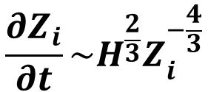
Fig. 4 illustrates an idealization of the vertical structure of the convective boundary layer, where the surface heat flux, H, depth of the layer z_{i}, and the temperature stratification just above z_{i} determine the vertical profile of temperature and heat flux.
A growth rate equation for z_{i}, in the absence of large-scale wind flow, which is proportional to
$$\frac{∂Z_{i}}{∂t}\sim H^{\frac{2}{3}}Z_{i}^{−\frac{4}{3}}$$
(9)
The entrainment of air from above zi to heights below z_{i} is given by
$$H_{z_{i}}=−∝H$$
(10)
where $∝$ is the entrainment coefficient ($∝≅$ 1.2).
McNider and Kopp (1990) discuss how the size of thermals generated from surface heating are a function of z_{i}, H, and height within the boundary layer.
Ref: William R Cotton

Slide 3
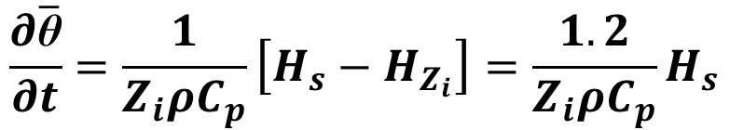
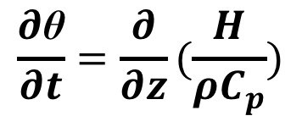

The rate of growth of the boundary layer during the day, and the ingestion of free atmospheric air into the boundary layer are, therefore, both dependent on the surface heat flux, H.
θ can be used to illustrate how temperature change is related to the surface heat flux, H_{s}
$$\frac{∂\text{θ}}{∂t}=\frac{∂}{∂z}(\frac{H}{ρC_{p}})$$
(11)
Where is the air density, and C_{p} is the specific heat at constant pressure.
Integrating from the surface to z_{i} and using the mean value theorem of calculus yields
$$\frac{∂\overline{\text{θ}}}{∂t}=\frac{1}{Z_{i}ρC_{p}}\left[H_{s}−H_{Z_{i}}\right]=\frac{1.2}{Z_{i}ρC_{p}}H_{s}$$
(12)
Where Eq. (10) with $α$= 1.2 has been used.
Ref: William R Cotton

Slide 4
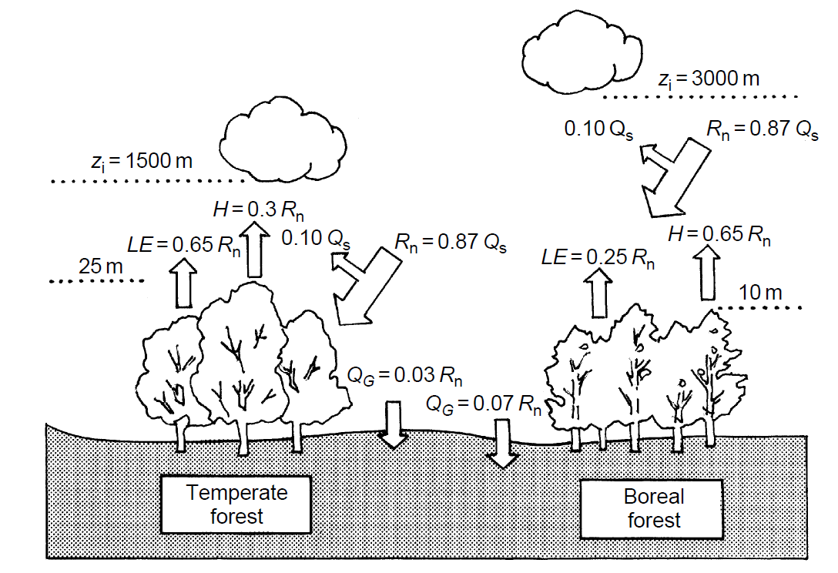
Fig 5 and Fig 6 show how H, and therefore other characteristics of the boundary layer, including z_{i}, as based on actual observations, are altered as a result of different land-surface characteristics.
Fig 5: Schematic of the differences in surface heat energy budget and planetary boundary layer over a temperate forest and or boreal forest. Horizontal fluxes of heat and heat storage by vegetation are left out of the figure (© 2001 American Geophysical.
Ref: William R Cotton

Slide 5
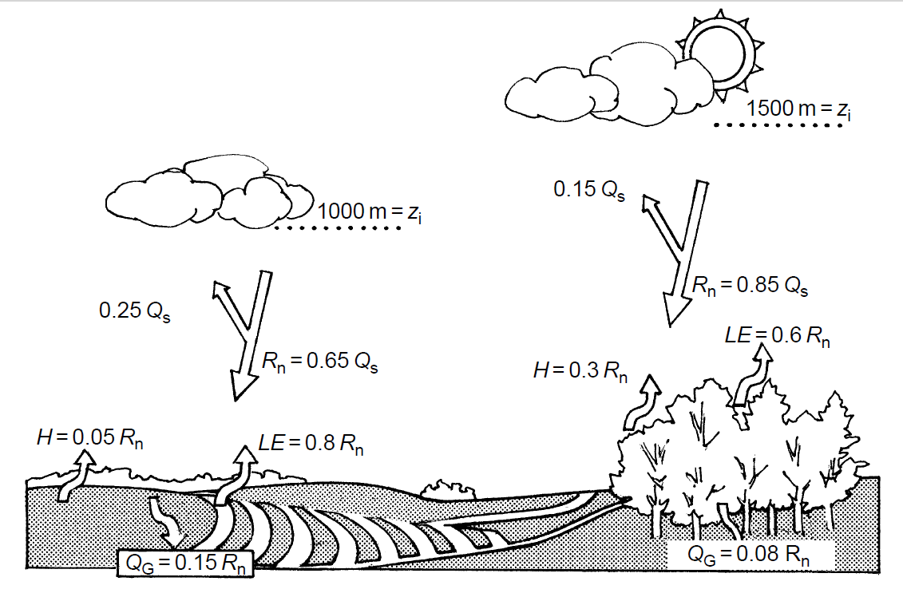
Fig 6: Same as Fig 5 except between a forest and cropland. © 2001 American Geophysical Union.
The boundary layer structure, including its depth, is directly influenced by the surface heat and moisture fluxes
Ref: William R Cotton

Slide 6
c. Local wind circulations
Local wind circulations can subsequently result from horizontal variations in H and z_{i} .Such wind circulations are referred to as solenoidal circulations and are the reason sea and land breezes occur.
Mesoscale circulations produce focused regions particularly favorable for deep cumulus convection. CAPE and other measures of the potential for deep cumulus convection are increased in response to boundary wind convergence associated with local wind circulations.
The spatial structure of the surface heating, as influenced by landscape, can produce focused regions for deep cumulonimbus convection, as well as other mesoscale systems.
Ref: William R Cotton

Slide 7
d. Vertical perspective
Land-surface characteristics influence the heating and moistening of the atmospheric boundary layer. Therefore, vertical radiosonde soundings over adjacent locations that have different surface conditions offer opportunities to observationally assess the effect of landscape variations, while models and observations can be used to evaluate the importance of spatially varying boundary-layer structure in generating mesoscale circulations.
The influence of landscape conditions on cumulus cloud and thunderstorm development have been evaluated using models and observations
e. Mesoscale and regional horizontal perspective
Surface heating associated with landscape patterns and patchiness would also produce mesoscale circulations. The shape of the heterogeneity strongly influences the ability of mesoscale flows to concentrate CAPE within local regions so as to permit a greater likelihood of stronger thunderstorms. The large square-shaped area, for example, is able to focus the lower tropospheric winds so as to optimize the accumulation of CAPE.
Ref: William R Cotton

Slide 8
2. Influence of irrigation
There is a Surface temperature contrasts between agricultural irrigated areas in juxtaposition to a grazed shortgrass prairie region
The emissivity of the irrigated area, however, is likely to be somewhat higher than that of its dryland surroundings. Therefore noticeable circulations should be expected to occur with such temperature gradients
The radiosonde sounding over an irrigated location had a slightly cooler, but moister lower troposphere than the sounding over the natural, shortgrass prairie location.
The moistening of the lower atmosphere over the irrigated area was more important in increasing CAPE than was the slight cooling in decreasing CAPE.
Ref: William R Cotton

Slide 9
Important physical changes between the natural shortgrass prairie of a region and the current land-use patterns include alterations in the surface albedo, roughness length changes, and increased soil moisture in the irrigated areas. These changes are capable of generating complex changes in the lower atmosphere (planetary boundary layer, PBL) energy budget.
From analyses of long-term surface climate data indicates a steady decreasing trend in mean and maximum air temperature at locations located within heavily irrigated areas thus supporting the irrigation-induced cooling effect
Ref: William R Cotton

Slide 10
3. Desertification
Desertification has an opposite effect on climate to that of irrigation
Vegetation loss due to human activities can, therefore, create deserts. The Rajasthan Desert in northwest India is an example of desertification. In that area, in the millennium before the Christian era, a well-developed civilization existed.
While the change in weather could have been part of the natural evolution of climate, major landscape changes by humans on the scale of the desert region have occurred elsewhere.
While natural large-scale fluctuations in climate could have caused the aridity
Removal of vegetation increased the albedo of the land. Local evaporation rates are as important as albedo in influencing rainfall patterns in semi-arid regions, with their relative effects dependent on location
Ref: William R Cotton

Slide 11
4. Deforestation
Deforestation is another type of landscape change. Deforestation occurs when lumbering and fires remove extensive areas of trees from a region.
More recent deforestation has occurred in the Amazon region and the influence of this removal of trees on global climate has been the subject of considerable interest
Major difference between the midlatitude forests and forests in the humid tropics such as the Amazon is the absence of substantial organic material and trace metals in the soils in the tropical environment.
The diurnal range of temperature is substantially greater over the cleared ground.
Ref: William R Cotton

Slide 12
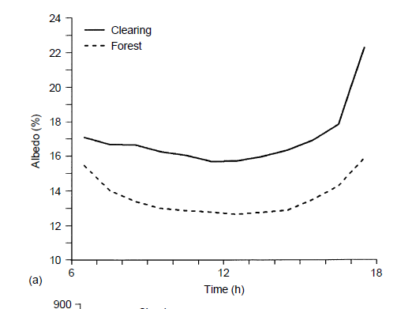
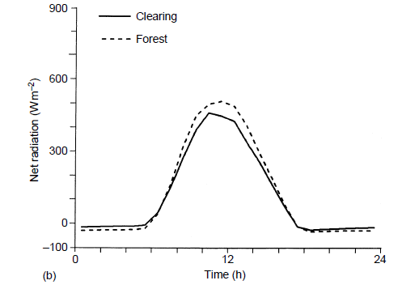
Fig 7: Mean hourly albedo at the clearing and forest sites in the Amazon for the study period from 12 October to 10 December 1990
Fig 8: Mean hourly net all-wave radiation at the clearing and forest sites for the same study period
Ref: William R Cotton

Slide 13
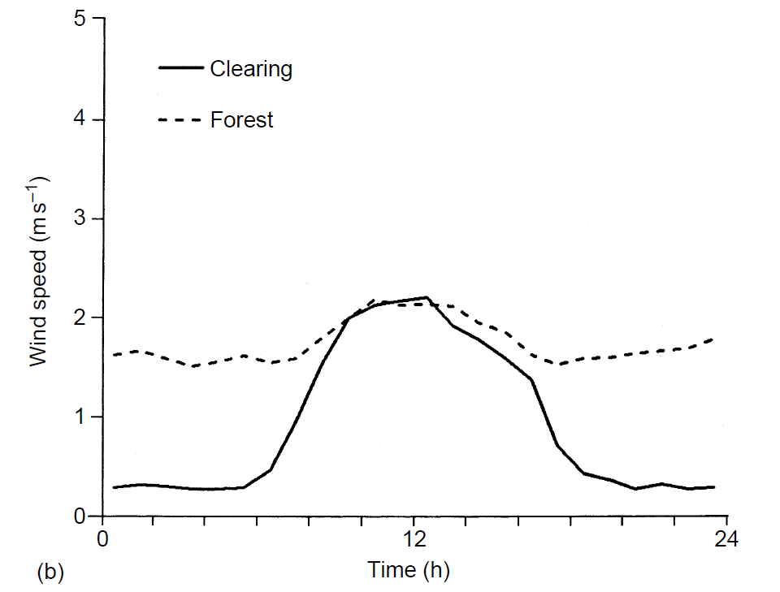
Fig 9: Mean hourly wind speed at clearing and forest sites in the Amazon
for the period 12 October to 10 December 1990
Ref: William R Cotton

Slide 14
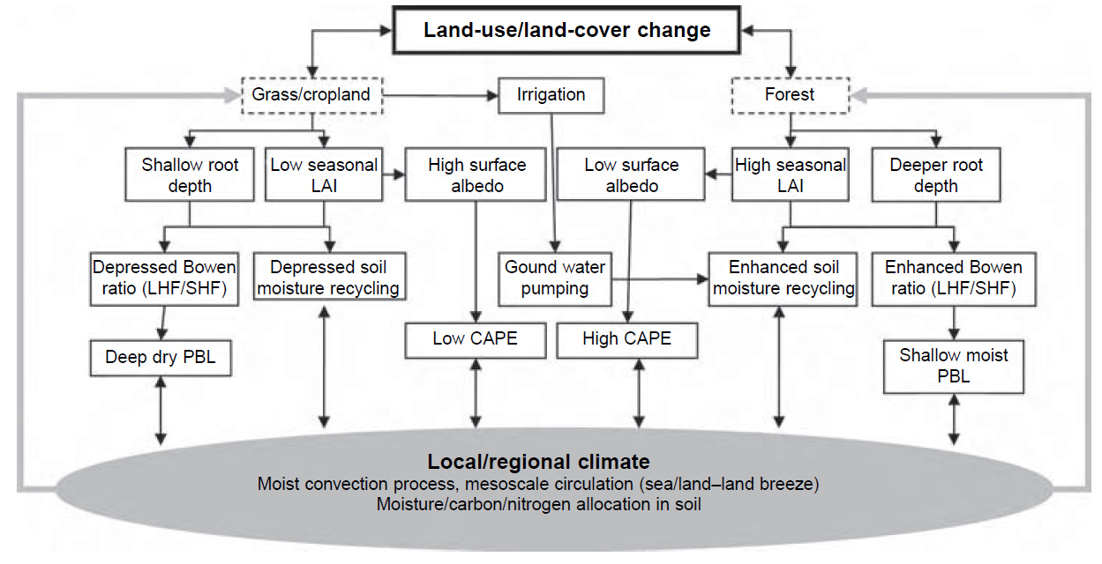
Fig 10: Hypotheses of the influence of land-use/land-cover change on regional climate
Note: leaf area index (LAI)
Ref: William R Cotton

Slide 15
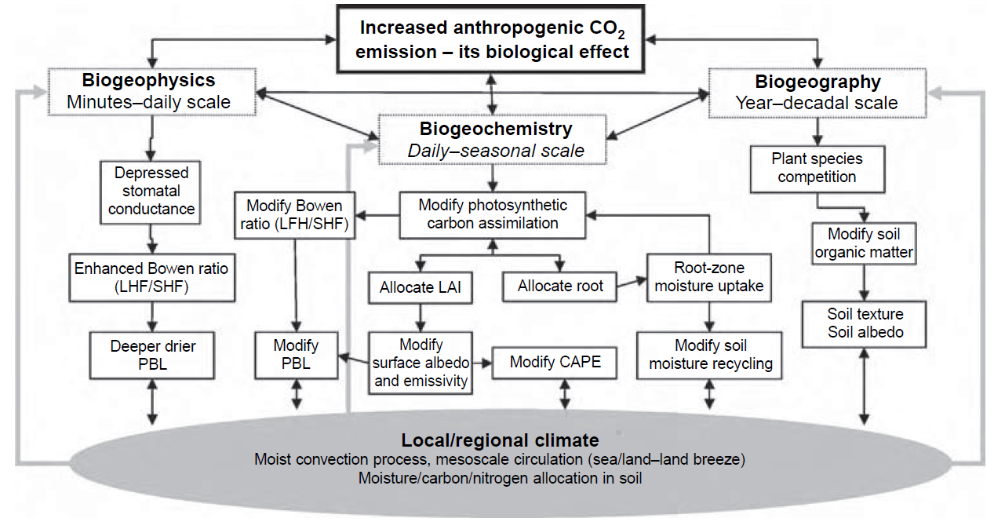
Fig 11: Increased carbon dioxide on biological activity as it influences weather
Ref: William R Cotton

Slide 16
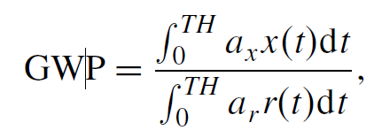
Quantifying land-use/land-cover forcing of climate
Carbon has become the currency used to assess the human intervention in the Earth’s climate system. Impacts on climate are compared in terms of radiative forcing, which can be considered as perturbations to the Earth’s radiation budget prior to feedbacks from the rest of the climate system.
The concept of global warming potential (GWP) where
(13)
Here,
TH is the time period over which the calculation is considered,
a_{x} is the radiative efficiency due to a unit change in atmospheric abundance of the substance x (i.e., Wm⁻² kg⁻¹), and
x(t) is the time-dependent decay of the abundance from an instantaneous release of the substance and r, defined to be carbon dioxide.
Ref: William R Cotton

Slide 17

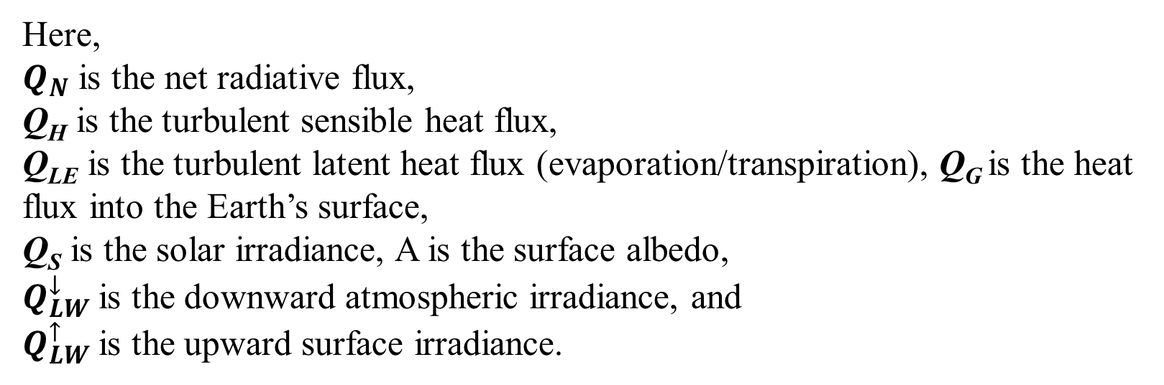
The partitioning of available energy into latent and sensible heat fluxes exerts a direct impact on near-surface air temperature, so a change in this partitioning should be considered a climate forcing.
With the surface heat energy being separated into
$$Q_{N}+Q_{H}+Q_{LE}+Q_{G}=0$$
(14)
Where
$$Q_{N}=Q_{S}\left(1−A\right)+Q_{LW}^{↓}{−Q}_{LW}^{↑}$$
Here,
$Q_{N}$ is the net radiative flux,
Q_{H} is the turbulent sensible heat flux,
Q_{LE} is the turbulent latent heat flux (evaporation/transpiration), Q_{G} is the heat flux into the Earth’s surface,
Q_{S} is the solar irradiance, A is the surface albedo,
$Q_{LW}^{↓}$is the downward atmospheric irradiance, and
$Q_{LW}^{↑}$is the upward surface irradiance.
Ref: William R Cotton

Slide 18
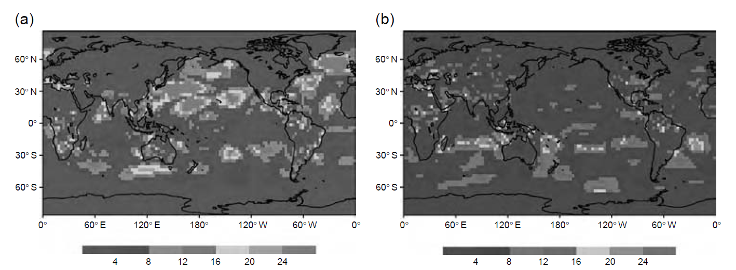
One measure of land-cover change forcing of climate could be the perturbation to one of the components of the surface energy balance equation (Eq. 14) prior to feedbacks from the rest of the climate system.
The 10-year average absolute value change in surface latent turbulent heat flux in Wm⁻² worldwide as a result of the land-use changes. (a) January surface latent turbulent heat flux, (b) July surface latent turbulent heat flux
Ref: William R Cotton

Slide 19
Atmosphere–vegetation interactions
The atmosphere and biosphere are coupled, dynamic systems
On daily timescales, vegetation interacts with the atmosphere through its direct influence on the partitioning between latent and sensible heat fluxes, as discussed
Several non-radiative forcings involve the biological components of the climate system. They can be categorized into three types.
Biophysical forcing involves changes in the fluxes of trace gases and heat between vegetation, soils, and the atmosphere.
Biogeochemical forcing involves changes in vegetation biomass and soils.
Biogeographic forcing involves alterations in plant species composition.
Ref: William R Cotton

